Slide 1
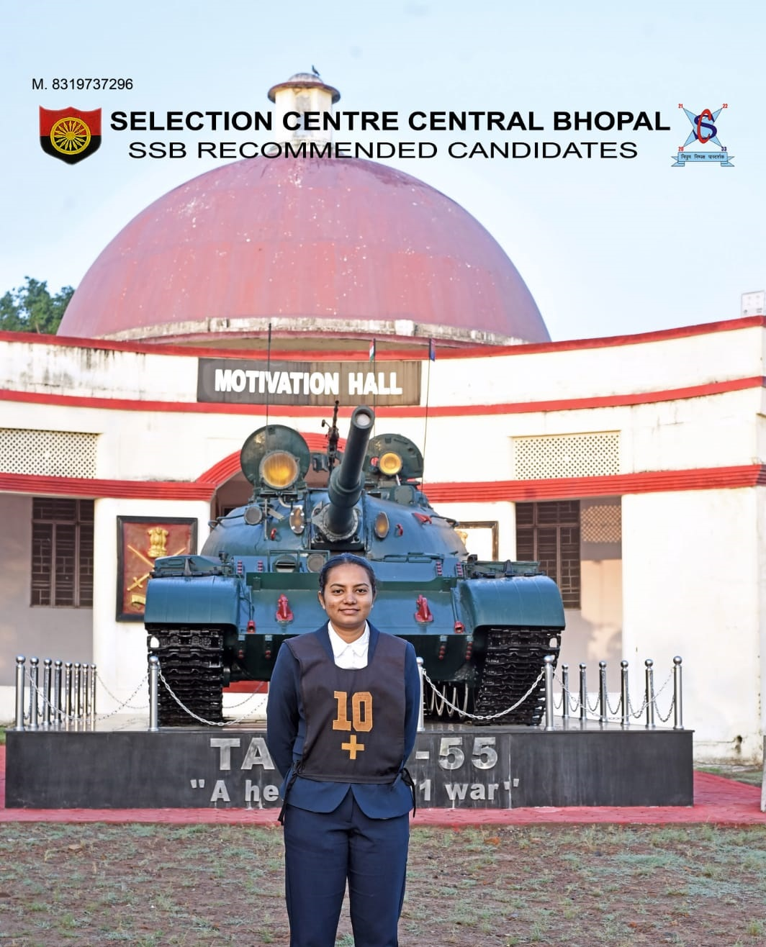
Congratulations to Miss Shyamli Vijay Jadhav, (2019 passout batch) from Department of Mechanical Engineering for selection as Officer Training Academy in Army training academy- Gaya through Short Service Commission (SSC).
Institute is incredibly proud of her accomplishment. Wishing her continued success as her embark on this noble path of service to our nation.
Well done!!!

