Slide 1
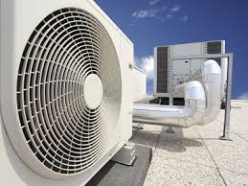
VIDYAVARDHINI’S COLLEGE OF ENGINEERING AND TECHNOLOGY,
K. T. MARG VASAI ROAD (W), PALGHAR 401202
One Week SDP on Heating, Ventilation, and Air Conditioning (HVAC) Skill Enhancement Program.
Conducted By
Daikin Airconditioning India Pvt. Ltd.
Organised By
Department of Mechanical Engineering and
Industry Institute Interaction Cell
VCET, Vasai
From
14th February 2022
to
18th February 2022

